Slide 1
Smart street lights
INNOVATION GEEKS
by: under the guidance of :
Y . Deepak(18r01a04c0) Mrs. M. naga GeethA
M . likhitha(18r01a0493) mr. nagaraja kumar

Slide 2
Problem
Street light play a vital role in our environment and also plays a critical role in providing light for safety during night time travel . In this scenario when the street light are in working functionality over the whole night that consumes a lot of energy

Slide 3
abstract
The main purpose of this project is to switch ON and OFF street lights without manual operation.
By using this system energy consumption is reduced.
IR sensors , LDR and Arduino are main components of the project.
IR sensor is like our eye which detect the presence of an object.

Slide 4
introduction
In the present days automated systems have less manual operations , high flexibility and accurate.
Especially in the field of electronics automated system are giving good performance.
Our project is to control the switching of street lights automatically.
IR’s which detects the vehicle with the Arduino used .
Our project is depend on solar power

Slide 5
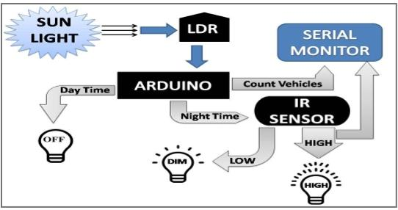
Block diagram

Slide 6
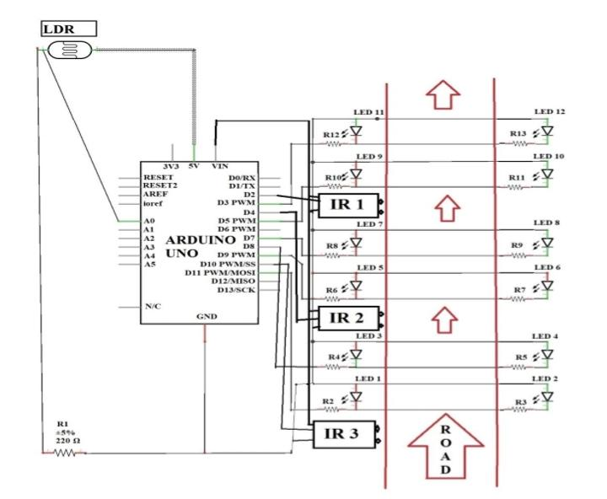
Schematic diagram

Slide 7
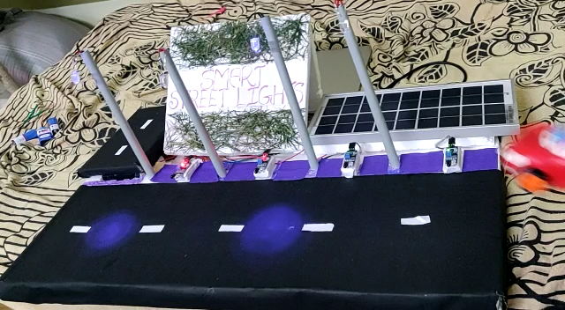
Prototype video

Slide 8
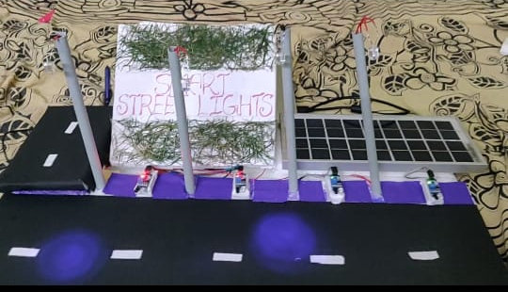
prototype

Slide 9
conclusion
Can overcome the crisis of natural power production resources in forth coming days.
These project not only help us in reducing the power consumption , but also to reduce accidents, criminal acitivites and maintenance costs
Ultimately can conserve some of the natural resources from completely getting vanished.

Slide 10
Thank you

